Slide 1
Module-1:
Python Basic Concepts and Programming

Slide 2
Module-1: Python Basic Concepts and Programming :
Interpreter, Parts of Python Programming Language, Identifiers, Keywords, Statements and Expressions, Variables, Operators, Precedence and Associativity, Data Types, Indentation, Comments, Program Execution, Reading Input, Print Output, Type Conversions, The type( ) Function and Is Operator, Control Flow Statements, The if Decision Control Flow Statement, The if…else Decision Control Flow Statement, The if…elif…else Decision Control Statement, Nested if Statement, The while Loop, The for Loop, The continue and break Statements, Sequences – Strings, Built-In Functions, Commonly Used Modules, Function Definition and Calling the Function, The return Statement and void Function, Scope and Lifetime of Variables, Default Parameters, Keyword Arguments, *args and **kwargs, Command Line Arguments.

Slide 3
Python Tokens:
In Python, tokens are the smallest units of the program that have a meaningful role. Python breaks every program into these tokens during the lexical analysis phase.
There are 5 types of Python tokens:
Keywords
Identifiers
Literals
String Literals
Numeric Literals
Boolean Literals
Special Literal (None)
Collection Literals
Operators
Punctuators

Slide 4
What is Python:
Python is an general purpose, Object-oriented, High-level, Dynamically Typed, Compiled and Interpreted programming language known for its simplicity and readability.
Common Uses of Python:
Web Development: Using frameworks like Django and Flask.
Data Analysis and Visualization: With libraries like Pandas, Matplotlib, and Seaborn.
Artificial Intelligence and Machine Learning: Leveraging tools like TensorFlow, PyTorch, and Scikit-learn.
Automation/Scripting: Automating repetitive tasks using Python scripts.
Game Development: Using libraries like Pygame.
Scientific Computing: Libraries like SciPy and SymPy are used for simulations and computations.
Software Development: For prototyping and backend development.

Slide 5
Interpretation in Python
The bytecode produced by the compilation step is executed by the Python Virtual Machine (PVM). The PVM interprets the bytecode line by line and executes it. This is what gives Python its "interpreted" behavior.
Key Points
Python is not a purely compiled language like C or C++, where code is compiled into machine code before execution.
Python is not a purely interpreted language like early versions of BASIC, which execute source code directly without compiling it.
Instead, Python uses a hybrid model: it compiles source code to bytecode (a form of intermediate code), which is then interpreted.

Slide 6
How Python is Compiled and Interpreted:
Python is often described as both a compiled and an interpreted language, depending on how you look at its execution process.
Compilation in Python:
When you run a Python program, it first goes through a compilation step.
The Python interpreter compiles the source code (.py file) into bytecode (a lower-level, platform-independent representation). This bytecode is stored in .pyc files (in the __pycache__ directory).
Note:
This compilation step is implicit and happens behind the scenes.
The bytecode is not directly executed by your machine; it is executed by the Python interpreter.

Slide 7
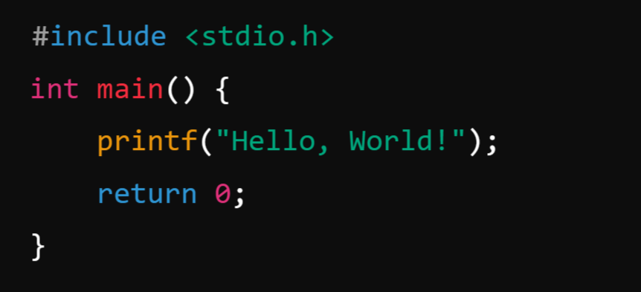
What is Compiler?
A compiler is a program that translates the entire source code of a programming language into machine code or intermediate code before execution. The compiled code is then executed directly by the computer's processor.
Example: C Language
Process: A C compiler (like GCC) compiles the code into a machine-readable .exe file, which can then be executed.

Slide 8

What is Interpreter?
An interpreter is a program that executes code line by line, translating it directly into machine code as it runs.
Example: Python:
Process: The Python interpreter reads the script line by line and executes it immediately.

Slide 9
Parts of Python Programming Language:
Python programming language consists of several essential components and parts that work together to provide its functionality and versatility.
Identifiers
Keywords
Statements and Expressions
Variables
Operators
Precedence and Associativity
Data Types
Indentation
Comments
Program Execution
Reading Input and Print Output

Slide 10
Identifiers:
Identifiers in Python are name given to the programming elements such as variables, functions, classes, or other objects. They serve as labels to reference these objects in code.
Python has specific rules and conventions for creating identifiers.
Example for Identifiers: Valid Identifiers:
my_variable
Variable123
_privateVar
MyClass

Slide 11
Rules for Creating Identifiers
1. Allowed Characters:
Identifiers can only contain letters (a-z, A-Z), digits (0-9), and underscores (_).
They cannot start with a digit. For example, 123abc is invalid, but abc123 is valid.
2. Case Sensitivity: Identifiers are case-sensitive. For example, MyVariable and myvariable are treated as distinct identifiers.
3. Keywords: Identifiers cannot be the same as Python's reserved keywords (e.g., if, while, class, def, etc.). Use the keyword module to view the list of reserved keywords in Python
4. Special Characters: Identifiers cannot include special characters like @, $, %, or spaces.
5. Length: Identifiers can be of any length, but it’s good practice to keep them concise and meaningful.
6. Underscore Usage:
A single leading underscore (_var): Used to indicate a private variable (not enforced by Python, but by convention).
Double leading underscores (__var): Used for name mangling in classes to avoid name conflicts in child.
Double underscores at both ends (__init__): Reserved for special methods or magic methods in Python.

Slide 12
Example for Invalid Identifiers:
123abc (Starts with a digit)
my-variable (Contains a hyphen)
class (Reserved keyword)
my variable (Contains a space)

Slide 13
Keywords:
Keywords in Python are reserved words that have a specific meaning and purpose in the language. They are part of Python's syntax and cannot be used as identifiers (e.g., variable names, function names, or class names).
Python keywords are case-sensitive and must be used exactly as defined.
Characteristics of Keywords:
Fixed Meaning: The meaning of a keyword is predefined and cannot be changed.
Case-Sensitive: Keywords must be used in lowercase (e.g., if is valid, but If is not).
Reserved: They cannot be used for naming variables, functions, or any other identifiers.

Slide 14
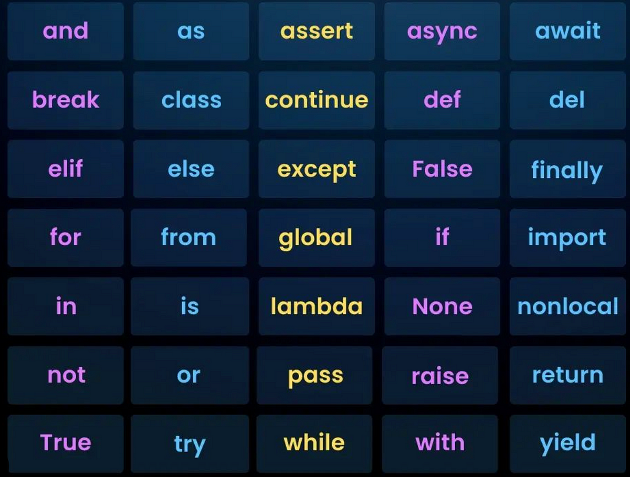
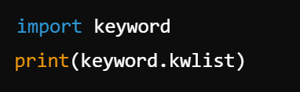
List of Keywords:
Python has a predefined set of keywords. You can get the current list of keywords using the keyword module:

Slide 15
Statements and Expressions:
In Python, statements and expressions are fundamental building blocks of the language. They serve different purposes and are essential for writing functional and efficient code.
Expressions:
An expression is a combination of values, variables, and operators. A value all by itself is considered an expression, and so is a variable.
Characteristics of Expressions:
Always return a value.
Can be part of a larger statement.
Examples include mathematical operations, function calls, or logical comparisons.

Slide 16
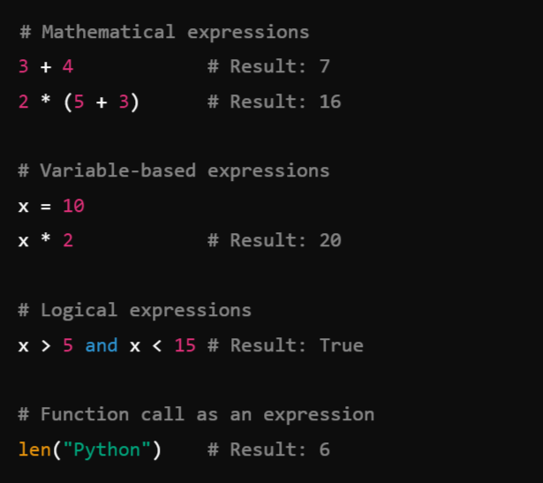
Example:
When you type an expression at the prompt, the interpreter evaluates it, which means that it finds the value of the expression.
In this example, x has the value 10 and x * 2 has the value 20.

Slide 17
Statements:
A statement is an instruction that Python executes. Statements may or may not produce a result, and they define the flow of a program.
A statement is a unit of code that has an effect, like creating a variable or displaying a value.
Characteristics of Statements:
Do not necessarily return a value.
Perform actions such as defining variables, loops, or conditionals.
Can include expressions as part of their structure.
Types of Statements:
Assignment Statement: Assigns a value to a variable.
Control Flow Statements: Includes if, for, while, etc.
Function and Class Definitions: def, class.
Import Statements: import, from.

Slide 18
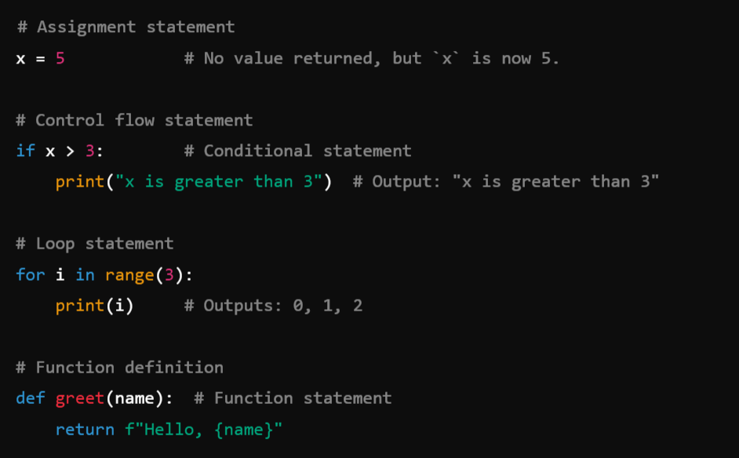
Example:

Slide 19
Key Differences Between Statements and Expressions:
Aspect | Expression | Statement
Definition | A combination of values and operators. | A complete instruction or action.
Returns a Value | Always returns a value. | May or may not return a value.
Examples | 5 + 3, x * 2, len("text") | x = 5, if, for, def, print()
Purpose | Produces a value. | Performs an action.

Slide 20
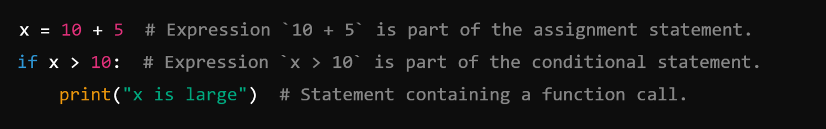
Expressions as Part of Statements: Expressions are often embedded within statements.
For example:
Summary:
Expressions: Produce values and can be part of a larger statement.
Statements: Perform actions and may contain expressions within them.

Slide 21
Variables:
In Python, variables are symbolic names that are used to reference objects in memory.
They are essentially labels that point to data stored in memory, enabling you to access and manipulate that data.
Variables are fundamental in programming and are used to store information that can be retrieved or modified during program execution.

Slide 22
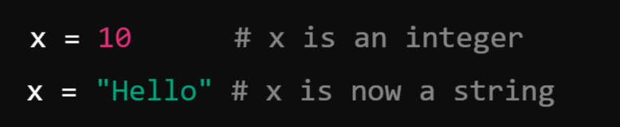
Key Characteristics of Variables in Python:
1. Dynamic Typing:
Python is a dynamically-typed language, meaning you do not need to declare the type of a variable explicitly. The type is inferred based on the value assigned to the variable.
Example:
2. No Explicit Declaration: Variables are created when you assign a value to them as Python is Dynamically Typed Language as compared to C and Java as they are statically Typed Languages.
3. Variable Naming Convention: As Variable is an Identifier, So it should follow the Rules for Creating Identifiers.
4. Memory Management: Python uses a garbage collector to manage memory automatically. Variables point to objects in memory, and when an object is no longer referenced, it is garbage collected.

Slide 23
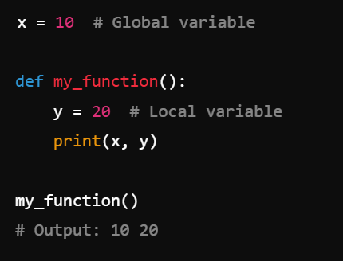
Global and Local Variables:
Global Variables: Defined outside a function and accessible throughout the program.
Local Variables: Defined inside a function and accessible only within that function.
Example:

Slide 24
Comments:
In Python, comments are lines of text within the code that are ignored by the Python interpreter. They are used to explain, document, and improve the readability of the code, making it easier for others (and yourself) to understand what the code does.
As programs get bigger and more complicated, they get more difficult to read. Formal languages are dense, and it is often difficult to look at a piece of code and figure out what it is doing, or why.
For this reason, it is a good idea to add notes to your programs to explain in natural language what the program is doing. These notes are called comments, and they start with the # symbol:

Slide 25
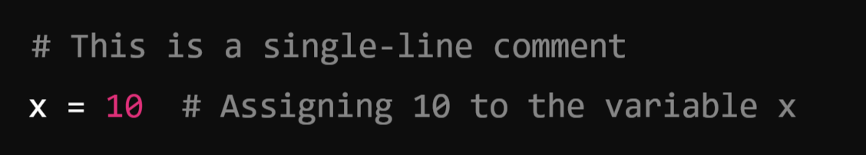
Types of Comments in Python
1. Single-Line Comments:
Begin with a hash symbol (#) and extend to the end of the line.
Used for brief explanations or notes.
Example:

Slide 26
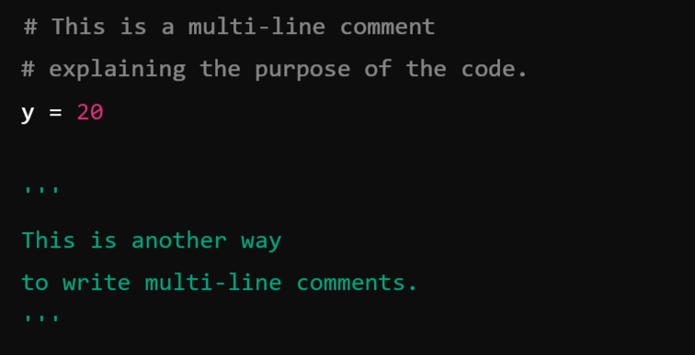
2. Multi-Line Comments:
Python does not have a special syntax for multi-line comments.
Instead, multi-line comments are achieved by using:
Multiple single-line comments.
Triple-quoted strings (''' or """) that are not assigned to any variable.
These are often used for longer explanations or temporary disabling of blocks of code.
Example:

Slide 27
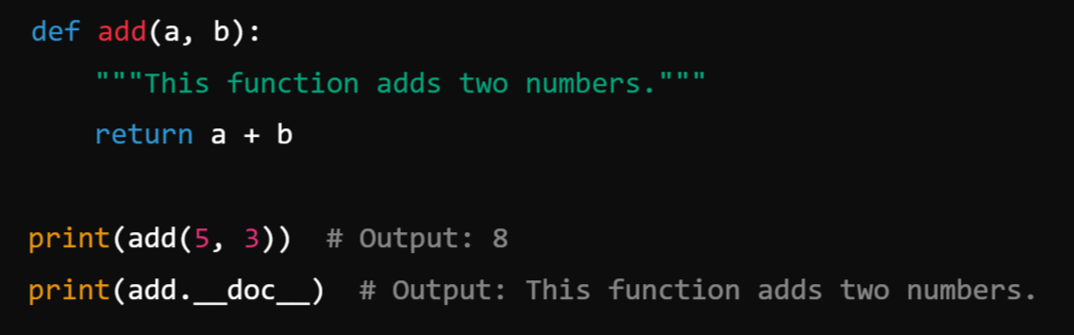
3. Documentation Strings (Docstrings):
Triple-quoted strings placed at the beginning of a module, class, or function to describe its purpose.
These are not technically comments but serve a similar purpose.
Accessible via the help() function in Python.
Example:

Slide 28
Module-1: Python Basic Concepts and Programming :
Interpreter, Parts of Python Programming Language, Identifiers, Keywords, Statements and Expressions, Variables, Operators, Precedence and Associativity, Data Types, Indentation, Comments, Program Execution, Reading Input, Print Output, Type Conversions, The type( ) Function and Is Operator, Control Flow Statements, The if Decision Control Flow Statement, The if…else Decision Control Flow Statement, The if…elif…else Decision Control Statement, Nested if Statement, The while Loop, The for Loop, The continue and break Statements, Sequences – Strings, Built-In Functions, Commonly Used Modules, Function Definition and Calling the Function, The return Statement and void Function, Scope and Lifetime of Variables, Default Parameters, Keyword Arguments, *args and **kwargs, Command Line Arguments.

